Slide 1

RECEIVE AND RESOLVE CUSTOMER COMPLAINTS
D1.HRS.CL1.15
Notes:
Trainer introduces himself/herself, students and topic area.

Slide 2

Subject Elements
This unit comprises four Elements:
Identify and analyse the complaint
Respond to complaints
Determine and agree upon appropriate action to resolve complaint
Refer complaints
Notes:
Trainer advises that this Unit comprises four Elements, as listed on the slide explaining:
• Each Element comprises a number of Performance Criteria which will be identified throughout the class and explained in detail
• Trainees can obtain more detail from their Trainee Manual
• At times the course presents advice and information about various protocols but where their workplace requirements differ to what is presented, the workplace practices and standards, as well as policies and procedures must be observed.

Slide 3
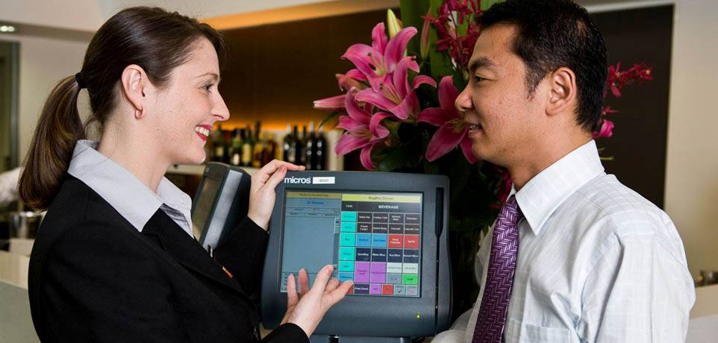
Assessment
Assessment for this unit may include:
Oral questions
Written questions
Work projects
Workplace observation of practical skills
Practical exercises
Formal report from supervisor
Notes:
Trainer advises that assessment for this Unit may take several forms, all of which are aimed at verifying they have achieved competency for the Unit as required.
Trainer indicates the methods of assessment that will be applied to them for this Unit.

Slide 4

Element 1: Identify and analyse the complaint
Notes:
Introduce topic.
Class Activity – General Discussion
Ask general questions:
What is a complaint?
What causes complaints?
What are common complaints?

Slide 5

Identify and analyse the complaint
Performance Criteria for this Element are:
Receive and accurately record a verbal complaint using active listening and empathy techniques
Identify through appropriate communication techniques the exact nature of the customer’s complaint
Maintain register or complaint file/s in accordance with the requirements of the enterprise’s information system
Notes:
Trainer identifies the Performance Criteria for this Element, as listed on the slide.

Slide 6

Complaints
Regardless of how well a business operates, problems will occur.
When problems occur, complaints are the common outcome that needs to be addressed:
Who is normally the cause of problems?
Notes:
Activity – Discussion
Answer the question in the slide

Slide 7

Complaints
Regardless of the complaint they must be:
Identified
Addressed in a timely manner
Resolved hopefully to the satisfaction of both the organisation and customer
Notes:
Activity – Discussion
How can you identify complaints?
Who normally handles complaints in the workplace?

Slide 8

Complaints
Quite often complaints arise when the customer’s:
Needs
Wishes
Expectations
are not met!
Notes:
Activity – Discussion
What is the difference between these three factors?
Are they the same for everyone?
Where do they come from?

Slide 9

Customer needs, wishes and expectations
Common problems in relation to customer service revolve around the concepts of customer needs, wishes and expectations
Customer service centres around an organisation’s ability to meet or exceed customer needs, wishes and expectations
Notes:
Activity – Discussion
How does an organisation try to understand a customer’s needs, wishes and expectations?
How can they meet or exceed these?

Slide 10
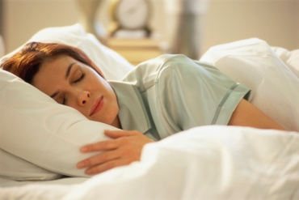
Customer needs
Needs
These underlie wishes and expectations and are the things customers are unable to do without.
They may be in a foreign town and simply cannot do without:
A bed for the night
A meal or beverage
A clean and hygienic environment
Notes:
Activity – Discussion
What are other common needs of customers in general?

Slide 11
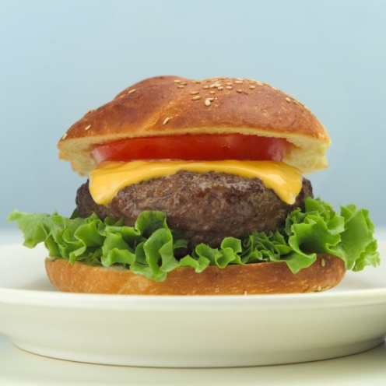
Customer needs
Generic customer needs
Whilst all the organisation’s customers have their own individual needs, there are a number of generic or common needs that staff must address when providing quality customer service.
Notes:
Activity – Discussion
What are common needs of customers when visiting hotels?
What do you expect as a minimum?

Slide 12
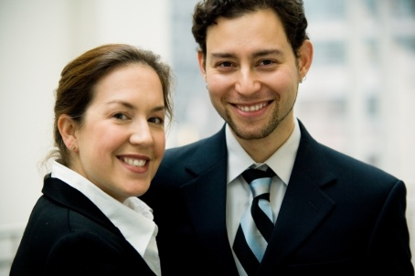
Customer needs
Generic customer needs
Value for money
‘Offering’ reflecting what was advertised
Expectations met or exceeded
To feel respected
To feel welcomed
To be served by friendly staff
Notes:
Activity – Discussion about generic customer needs
Which hotels do you know of that provide for these customer needs?
Value for money
‘Offering’ reflecting what was advertised
Expectations met or exceeded
To feel respected which is why we use “Sir” and “Madam”
To feel welcomed which is why we give all our customers a warm, genuine and sincere smile and welcome. We really are pleased to see them
To be served by friendly staff which is again why we smile and why we spend that extra few seconds with them, talking about how their day went and so on
To be dealt with in a prompt and courteous manner which is why we don’t keep them waiting at reception, the bar, for room service or meals

Slide 13
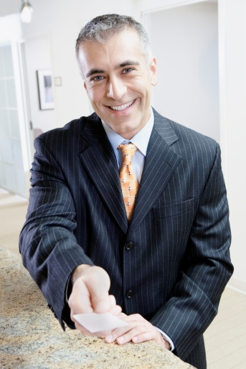
Customer needs
Generic customer needs
To be dealt with in a prompt and courteous manner
To receive assistance when necessary
To be in comfortable, clean surroundings
To feel remembered and recognised
To be heard and understood
Notes:
Activity – Discussion about generic customer needs
Which hotels do you know of that provide for these customer needs?
To be dealt with in a prompt and courteous manner which is why we don’t keep them waiting at reception, the bar, for room service, meals etc
To receive assistance when necessary which is why we have excellent product and local knowledge and why we look for opportunities to pass this on to them whenever we can, even without their having to ask
To be in comfortable, clean surroundings which is why we make sure the facilities, rooms, grounds and equipment are spotless
To feel remembered and recognised which is why we use the customer’s name as often as we can
To be heard and understood which is why we listen to complaints and adopt the role of their advocate whenever there is a complaint, problem or dispute. We want to fix their problems, not create new ones.

Slide 14
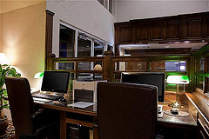
Customer needs
Specific target market needs
Business:
Computer and internet access
Newspapers
Executive lounges
Laundry services
Business and news channels
Notes:
Activity – Discussion about how hotels cater to specific customer needs
What other ways can a hotel cater to the needs of this particular market segment?

Slide 15

Customer needs
Specific target market needs
Women:
Hairdryers
Larger mirrors
Healthier food options
Specific bathroom amenities
Fashion magazines
Bath
Notes:
Activity – Discussion about how hotels cater to specific customer needs
What other ways can a hotel cater to the needs of this particular market segment?

Slide 16
Customer needs
Specific target market needs
Family:
Interconnecting rooms
All inclusive packages
Entertainment options
Child care facilities & Children’s television programs
Handicapped facilities &/or disabled toilets
Safety
Notes:
Activity – Discussion about how hotels cater to specific customer needs
What other ways can a hotel cater to the needs of this particular market segment?

Slide 17
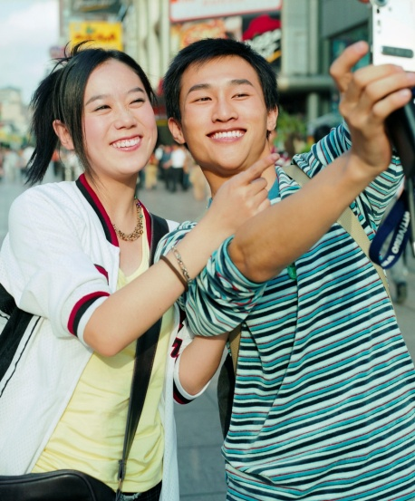
Customer needs
Specific target market needs
Leisure:
Cheaper rates
Local attractions
Concierge services
Activities
Notes:
Activity – Discussion about how hotels cater to specific customer needs
What other ways can a hotel cater to the needs of this particular market segment?

Slide 18
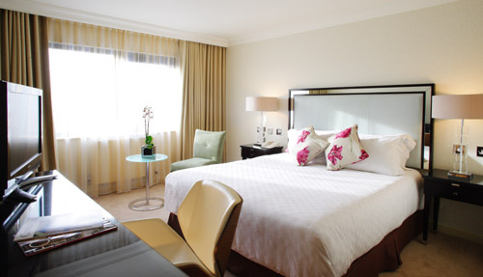
Customer needs
Specific target market needs
Elderly:
Single beds
Medical facilities
Suitable food options
Cheaper rates
Notes:
Activity – Discussion about how hotels cater to specific customer needs
What other ways can a hotel cater to the needs of this particular market segment?

Slide 19
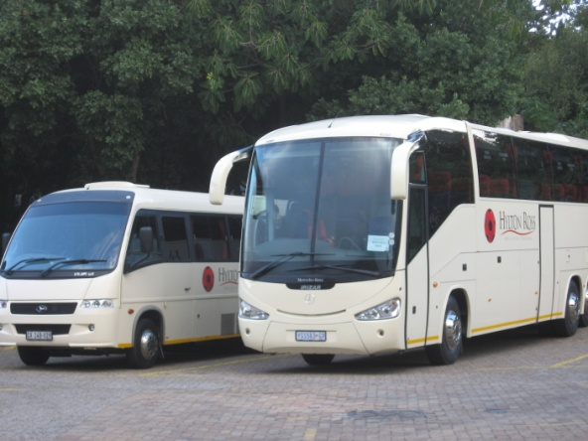
Customer needs
Specific target market needs
Groups:
Need for large allocation of rooms
Cheap rates
Meeting rooms
Specialised menus
Bus access and parking
Notes:
Activity – Discussion about how hotels cater to specific customer needs
What other ways can a hotel cater to the needs of this particular market segment?

Slide 20

Customer wishes
Wishes
These refer to the way in which our customer would prefer to satisfy a specific need, but they may not have the resources to meet these wishes.
They may wish to:
Stay in the luxury suite
Dine at an internationally renowned, 5 star fine dining restaurant
Drink expensive champagne
Notes:
Activity – Discussion
What is the difference between a need and a wish?
Can hotels provide both?

Slide 21

Customer expectations
Customers have perceived expectations of what level of service they expect when visiting a venue:
Where do expectations come from?
Notes:
Activity – Discussion about customer expectations
Where do expectations come from?

Slide 22

Customer expectations
Origins of customer expectations
The company’s image or reputation in the market
Past visits
Advertisements and promotional messages
Competing hotels
Industry standards
Comments from family, friends and colleagues
Price charged for the offering
Notes:
Activity – Discussion about customer expectations
Where else do expectations come from?

Slide 23

Complaints
As mentioned, complaints arise when customers’ needs, wishes or expectations are not met
Complaints are a common part of any organisation
It is unrealistic to think that everyone will be happy, every day
Notes:
Activity – Complaints
How should complaints be handled?

Slide 24

Complaints
Keys to handling complaints
Three keys to respond to customer complaints are to be:
Positive
Sensitive
Polite
Notes:
Activity – Complaints
Why should complaints be seen as a positive thing?
How can you show sensitivity?

Slide 25

Complaints
Types of complaints
Rude staff and management
Difficult or demanding customers
Lack of service, or poor, service
Expectations not being met
Dissatisfaction with the accommodation
Services are poor
Notes:
Activity – Discuss the common types of complaints
Rude staff and management. This is a major cause of customer complaints
Difficult or demanding customers. Some customers are especially difficult to deal with and extremely demanding in their orders and the way they ‘ask’ for service.
Lack of or poor service. This can involve the customer having to wait ‘too long’, the quality of products being sub-standard, staff who are disrespectful, rude or offensive when they deliver service
Expectations not being met. The advertisements that your venue runs, coupled with word-of-mouth advertising, create these expectations and they may often be unrealistic. Customers can be frustrated and disappointed when reality fails to match either the advertisements or the expectations, and conflict can often result. This classification is a common one with special needs customers
Dissatisfaction with the accommodation. For example the room facilities are not working or are outdated, the room may smell of smoke, is too noisy or the view is not what was anticipated
Services are poor. Details may have been forgotten or the general level of service is insufficient and slow

Slide 26

Complaints
Types of complaints
Unhygienic conditions
Low comfort levels
Rowdy and unacceptable behaviour displayed by other customers
A mistake with an account
Error in the reservation or booking
Special requests not being adhered to
Notes:
Activity – Discuss the common types of complaints
Unhygienic conditions – perhaps where the guest room or any facility enjoyed by customers shows a lack of proper attention to detail and incorrect housekeeping practices.
Low comfort levels – an area of the property could have been too cold, too noisy, or too crowded
Rowdy and unacceptable behaviour displayed by other customers – the room or table next to the customer may have been patronised by a noisy and boisterous customer
A mistake with an account – the guest account may have charged for items that should have been on someone else’s bill, or over-charged for a product or service
Error in the reservation or booking or not found – the guest may have arrived to find there was a problem with a booking or reservation that they had been led to believe was guaranteed and problem-free
Special requests not being adhered to – the flowers and champagne that were ordered for 4:00 PM were not delivered and spoiled a very special occasion.

Slide 27

Complaints
Types of complaints
Limited or no rooms/tables available
Requirement to guarantee a reservation
Inflexibility in methods of payment
Hidden charges
Ejection from the premises
Notes:
Activity – Discuss the common types of complaints
Limited or no rooms/tables available. Every business has a capacity on how many customers can be served, seated or accommodated at one time.
Requirement to guarantee a reservation. Many organisations will have a guarantee policy to ensure they can maximise revenues for outlets. If inflexible conditions exist, it may irritate potential or existing customers
Inflexibility of methods of payment. A customer may wish to offer payment which the establishment may accept. Possible situations may include an organisation’s refusal to take cheques or American Express payments
Hidden charges. This may include taxes or service fees the customer did not expect or was not told about
Ejection from the premises e.g. if a customer has to be removed from the premises for whatever reason.

Slide 28
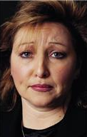
Complaints
Warning signs of a complaint
Usually, before someone makes a complaint, they give outward signs of their dissatisfaction:
What are possible warning signs that a customer is about to complain?
Can all complaints be predicted?
Notes:
Activity – Questions
Discuss questions in the slide

Slide 29

Complaints
Warning signs of a complaint
Some signs of dissatisfaction include negative changes in:
Body language
Voice
Actions
Notes:
Activity – Questions
What changes are evident?
What should you do if a customer looks happy but has not come up to you to complain?

Slide 30

Complaints
Warning signs of a complaint
Common actions a guest may make when about to complain includes:
Look angry or aggressive
Appear flustered or frustrated
Display contorted facial expressions
Glance around as if seeking assistance
Physically touch another guest or colleague
Become too loud
Become argumentative
Notes:
Activity – Questions
Discuss these warning signs
As a customer what do you do?

Slide 31
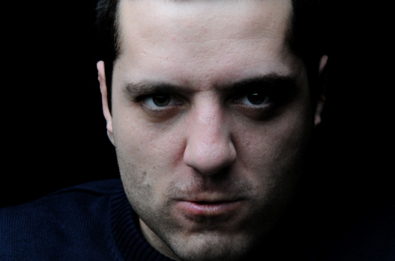
Complaints
Delivery of complaints
There are a number of ways in which a complaint is brought to the attention of staff and management:
Written complaints
Verbal – face to face
Verbal - telephone
Notes:
Activity – Questions
Written complaints including by letter, email, complaint or customer feedback forms
Verbal – face to face complaints
Verbal - complaints over the telephone
Which is the most popular method and why?

Slide 32

Complaints
Deal with complaints sensitively, courteously and discreetly
When handling all compliant situations it is important to deal with them in a manner that is:
Friendly
Efficient
Respectful
Courteous
Thorough
Notes:
Activity – Discussion
Discuss the importance of each of these points when handling complaints

Slide 33

Complaints
Being sensitive
Being sensitive when dealing with a customer complaint asks you to:
Take all complaints seriously
Take time to assess the environment
Factor in relevant issues
Approach each situation appropriately
Make requests and suggestions to people
Notes:
Activity – Discussion
Discuss the importance of each of these points when handling complaints

Slide 34

Complaints
Being courteous
Being courteous means being polite:
Use people’s name, where known
Say ‘please’ when asking them to do something
Say ‘thank you’ if they comply with a request
Demonstrate respect for them
Use open gestures
Notes:
Activity – Discussion
Discuss the importance of each of these points when handling complaints

Slide 35

Complaints
Being discreet
Being discreet when dealing with complaints asks you to:
Talk quietly to the person
Remove the person to another area, if possible
Take whatever action is appropriate to deal with the situation without drawing unnecessary attention to it
Notes:
Activity – Discussion
Discuss the importance of each of these points when handling complaints

Slide 36

Handling complaints
Handling complaints
What, in your opinion is the best way to handle complaints?
What would you do first?
Notes:
Activity – Discussion to generate interest in techniques used to handle customer complaints
Discuss the questions in the slide

Slide 37

Greeting the customer
Handling complaints
Greet them
Identify yourself
Identify who the guest is
Thank them for bringing the complaint to their attention
Notes:
Activity – Discuss and Role Play
Discuss the initial customer resolution steps
Trainer may role play the scenario

Slide 38
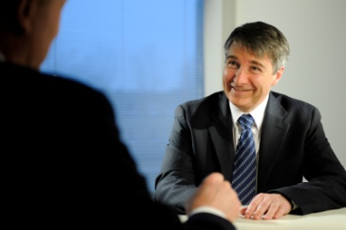
Greeting the customer
Handling complaints
Offer assistance in trying to find a suitable solution to their complaint
Take the person to a suitable location
Depending on the situation, you may wish to offer them a refreshment
Notes:
Activity – Discuss and Role Play
Discuss the initial customer resolution steps
Trainer may role play the scenario

Slide 39

Use effective communication
Once we have greeted the customer, one of the most important aspects of handling customer complaints effectively is through the use of effective communication:
What ways do we communicate with each other?
Notes:
Activity – Discussion and demonstration
How do we communicate with each other?
Trainer to demonstrate different communication methods

Slide 40
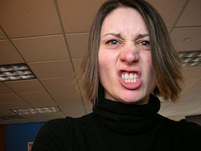
Use effective communication
Communication skills
Communication involves sending and receiving messages:
Verbally
Non-verbally
Notes:
Activity – Discussion and demonstration
What are examples of each type of communication?
Which type is more evident?

Slide 41
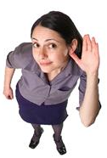
Use effective communication
Communication skills – verbal
Listening
Questioning
Speaking
Notes:
Activity – Discussion
What is the purpose of each of these communication methods?

Slide 42

Use effective communication
Communication skills – non-verbal
Facial expressions
Eye contact
Gestures
Posture
Notes:
Activity – Discussion
Can you hide non-verbal communication?

Slide 43

Use effective communication
Interpersonal skills
The following skills are important for effective workplace communication:
Face the person you are talking with
Maintain eye contact if possible
Address the person by their name
Establish a rapport
Notes:
Activity – Discussion and demonstration
Why is the use of interpersonal skills so important when handling complaints?

Slide 44

Verbal communication
Listening
At this time the most important thing to do is to listen so you can:
Identify the main points of the complaint
Separate the actual aspects of the complaint from the emotion
Identify a possible suggested solution
The customer must be given the time to say their piece!
Notes:
Activity – Discussion
What is the difference between hearing and listening?
Why should you not interrupt someone?

Slide 45

Verbal communication
Questioning
Asking questions also enables you to:
Acquire more accurate information
Identify what the other person wants in order to solve the complaint
Demonstrate you are actively and genuinely interested in resolving the complaint
Clarify ambiguities
Better understand contexts
Notes:
Activity – Discussion
What types of questions can you ask?

Slide 46

Verbal communication
Types of questions
Closed questions:
Asking closed questions clarifies or confirms information
Simple ‘Yes” or “No” answer
Open questions:
Asking open questions is often used to gain more information
Notes:
Activity – Discussion
Trainer asks the trainees to provide some examples of closed and open questions

Slide 47

Verbal communication
Questioning techniques
Useful techniques when questioning people to obtain information about a complaint or to determine a possible solution are to:
Rephrase or repeat questions
Paraphrase the responses they have given you
Notes:
Activity – Discussion
Why is this important?

Slide 48
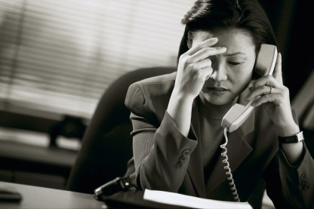
Non verbal communication
Observing customer’s body language
When we listen and question, we are also:
Watching to identify non-verbal communication
Analysing what the person is saying
Interpreting the words and the body language
Notes:
Activity – Discussion
What is this important?

Slide 49
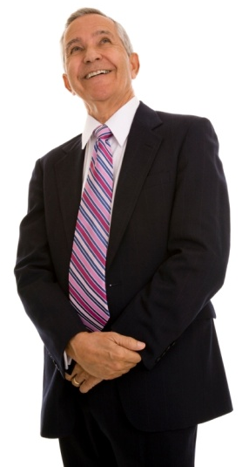
Non verbal communication
Transmitting body language
You need to pay attention to the messages your body language is sending when dealing with a conflict situation:
Your stance and posture
Your facial expressions
How you hold your arms
Notes:
Activity – Discussion
Why is this important?

Slide 50

Recording complaint details
Write information
When the customer is talking, it is important that you write the information down as it:
Helps identify the actual aspects of the complaint
Shows you have taken the complaint seriously
Notes:
Activity – Discussion
Discuss the importance of writing information down

Slide 51

Recording complaint details
Repeat information
Once the customer has finished explaining their complaint, it is worthwhile to repeat back the complaint to the customer.
This allows you to establish:
The scope and nature of the problem
Any history that might accompany it
Notes:
Activity – Discussion
Why is this important?

Slide 52

Recording complaint details
Repeat information
Repeating information is important as it:
Shows that you have indeed been listening
States the complaint, without the emotion – normally making the complaint less serious
Ensures the complaint is correct
Acts as a basis to work towards a solution
Notes:
Activity – Discussion
Why is it important to take out the ‘emotion’ and to identify just the facts?

Slide 53

Speaking
Now that we have listened and asked questions to identify the aspects of the complaint it is now time to work towards finding an acceptable solution
It is now our time to speak and to start the process towards reaching a solution to the complaint
Notes:
Activity – Discussion
What should the focus of your discussion be on?

Slide 54

Speaking
The effectiveness of our communication will be influenced by various elements of our speech.
These elements are:
Pitch or tone
Intensity
Projection
The pauses we use in our speech
Notes:
Activity – Discussion
What should the focus on your discussion be on?

Slide 55

Speaking
Stay calm and positive
A positive and cooperative manner can help to:
Smooth over a potentially problematic situation
Demonstrate your willingness to resolve the issue
Create an initial friendly atmosphere
Maintain positive customer relations
Notes:
Activity – Discussion
How else can you keep this delicate situation positive?

Slide 56
Speaking
Apologise for problem and inconvenience
One of the first things that we communicate in our response is to acknowledge that a complaint exists:
Thank the customer for bringing the complaint to them
Acknowledge that a problem has occurred
Acknowledge the inconvenience
Apologise for it
Notes:
Activity – Discussion
Why is this important?
Do you always need to apologise?

Slide 57

Clarify details of the complaint
Defining the complaint
An essential factor in resolving complaints is that:
The nature and details of the conflict are identified
Accepted by everyone as being at the heart of the issue
Notes:
Activity – Discussion
How can you define the nature and details of the complaint?

Slide 58

Clarify details of the complaint
Defining the complaint
Names of those involved
Details of times, dates, figures, amounts
Identification of exact service or products that failed
The factual details
Actions or inactions taken (or not taken) by staff or other people
Notes:
Activity – Discussion
Is there any other information you would like to know?

Slide 59
Agree on details of the complaint
Agree on the nature and details of the complaint
Repeat back to the person what they have told you
Elicit additional information and clarification
Obtain assurance that what they have told you constitutes the entire complaint
Confirm they are genuinely seeking a solution to what has been described
Notes:
Activity – Discussion
Why is it important to agree on the nature of the complaint?

Slide 60
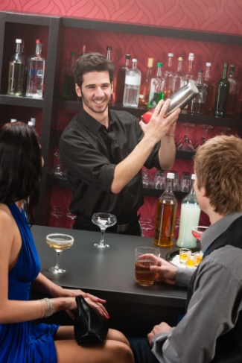
Handling alcohol related complaints
Whilst most complaints are not influenced by alcohol, it is important to handle these situations, when they arise, in a professional manner:
Why is handling complaints involving alcohol different?
How do you handle these situations?
Notes:
Activity – Discussion
Discuss questions in the slide.

Slide 61
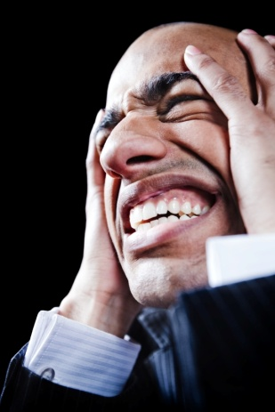
Handling alcohol related complaints
Tips for handling alcohol related complaints
Identify situations where problems may arise as early as possible
Try to involve the customer by providing options
Treat the customer professionally
Don’t touch the customer, where possible
Take action as early as possible
Follow all house policies, rules and regulations
Notes:
Activity – Discussion
What else can help when trying to negotiate with a drunk person?

Slide 62

Keeping written documentation
Whenever a complaint is received it is common policy for many hospitality establishments to keep a written record of it:
What are the benefits of keeping a written record of information?
Notes:
Activity – Discussion
Outline the benefits

Slide 63

Keeping written documentation
Benefits of written documentation
Establishes a clear record of facts relating to a complaint
Identifies any communication or action taken place to date
Keeps facts of a complaint accurate and impartial
Is helpful for additional internal and external parties who may later become involved in the complaint resolution process
Notes:
Activity – Discussion
Discuss these benefits

Slide 64

Keeping written documentation
Benefits of written documentation
Can be used as a reference for similar complaints in the future
Acts as an evidence source if additional costs are incurred
Acts as a tool to identify common problems which are to be investigated
Generates a pool of ‘guest preferences’ which can be used in the future to avoid further complaints
Notes:
Activity – Discussion
Discuss these benefits

Slide 65

Keeping written documentation
Complete any necessary documentation accurately
Regardless of the documentation to be used, all information recorded should be completed:
Accurately and honestly
Clearly
Comprehensively
Notes:
Activity – Discussion
What forms or records are used when recording complaint information?
Who keeps this information?

Slide 66

Keeping written documentation
Complete any necessary documentation accurately
It is imperative that all staff have an understanding of:
The internal forms and reports that need to be completed
The mandatory registers that need to be completed
When to complete forms, reports or registers
Who is allowed to complete them
The time within which they must be completed
Notes:
Activity – Discussion
Does a written record need to be completed for each and every complaint?
Why/why not?

Slide 67

Element 2:
Respond to complaints
Notes:
Introduce topic.
Class Activity – General Discussion
Ask general questions:
Once you have received a complaint and have agreed on its nature, what is the next step?

Slide 68

Respond to complaints
Performance Criteria for this Element are:
Process complaints in accordance with organisational standards, policies and procedures
Obtain and review documentation in relation to complaints
Maintain register of complaints/disputes
Notes:
Trainer identifies the Performance Criteria for this Element, as listed on the slide.

Slide 69
Processing complaints
Once complaints have been received, agreed and documented it is now time to:
Process the complaint
Hopefully find a solution
That is of benefit to both the customer and the organisation
Notes:
Activity – Discussion
Discuss the importance of these points.
What considerations are there that will impact on how a solution is made?

Slide 70

Processing complaints considerations
Organisational standards, policies and procedures
When processing complaints they must be done in compliance with organisational:
Standards
Policies
Procedures
Notes:
Activity – Discussion and Provide examples
What is the difference between standards, policies and procedures?
Trainer to show examples of organisational standards, policies and procedures?

Slide 71

Processing complaints considerations
Code of ethics
A code of ethics, also referred to as a code of conduct, outlines how it will handle various issues including customer complaints:
What is included in a ‘Code of Ethics’?
Notes:
Activity – Discussion
Discuss possible topics that are included in a ‘Code of Ethics’

Slide 72

Processing complaints considerations
Code of ethics
The code of ethics may focus on ensuring:
Complaints can be submitted easily
All complaints are taken seriously
Timely responses are given in a prompt and polite manner
Notes:
Activity – Discussion
Discuss how to ensure these topics can be measured or maintained?

Slide 73

Processing complaints considerations
Code of ethics
The code of ethics may focus on ensuring:
All action will be communicated in a timely manner
Complaints will be investigated and where possible, learnt from
All complaints will remain confidential or to protect the privacy of parties
Notes:
Activity – Discussion
Discuss how to ensure these topics can be measured or maintained?

Slide 74

Processing complaints considerations
Quality systems, standards and guidelines
Each organisation will have an accepted level of performance that must be obtained in handling customer complaints.
These may include stated:
Objectives
Rules
Guidelines
Notes:
Activity – Discussion
What are examples of ‘an accepted level of performance’?
Is this possible to measure?
Where is this information held?
How do staff know about these standards?

Slide 75
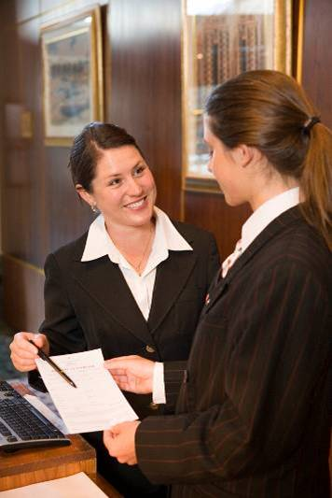
Processing complaints considerations
Scope of authority
All staff are under a legal obligation to only act within their specifically assigned scope of authority, relating to:
Their ability to act on behalf of the venue
Their authority to spend money on behalf of the venue
Their authority to act in given situations
Notes:
Activity – Discussion
What are examples of complaints which can be managed by:
Staff themselves?
Supervisors?
Senior Management?
Foe each of these positions what is included in their ‘scope of authority’ when handling complaints and taking action?

Slide 76

Processing complaints considerations
Complaints procedures
All organisations will have set procedures that must be followed in the event that a customer complaint has been submitted:
What will these procedures identify?
Notes:
Activity – Discussion
Discuss question in the slide.

Slide 77
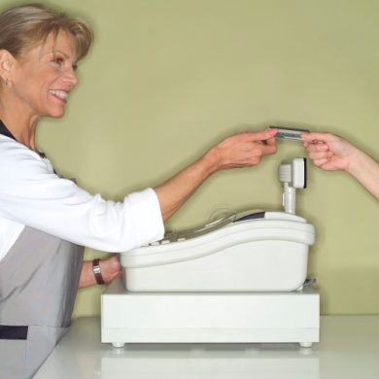
Processing complaints considerations
Complaints procedures
How complaints can be lodged
Who can handle the complaints
Timelines for handling complaints
Timelines and documents to be completed
Reporting process
Level of authority
Steps to follow if complaint process or decision is not satisfactory
Notes:
Activity – Discussion
Discuss the different procedural inclusions.

Slide 78

Processing complaints considerations
Third party documents
Where external parties will be required to handle aspects of a complaint, they will have their own policies and procedures that must be addressed and followed:
Police
Medical/hospitals
Insurance companies
Embassies and consulates
Airlines, car hire and other transportation providers
Notes:
Activity – Discussion
When are these external parties involved?
What types of information or documentation will they require?

Slide 79

Review documents/evidence
One of the key requirements of any investigatory activity in relation to a customer complaint is to collect evidence of problems that have lead to the complaint itself:
Why is it important to collect and review evidence?
Notes:
Activity – Discussion
Discuss question in the slide.

Slide 80

Review documents/evidence
Purpose of collecting evidence
Helps to identify:
Truth behind a complaint
Extent of the complaint
Cause of the problem
Who is responsible
Level of liability
Areas for improvement in the future
Notes:
Activity – Discussion
How can you collect evidence?
What are you looking for when collecting evidence?

Slide 81

Review documents/evidence
Identify sources of problems
Where complaints take place, there must be a reason why a specific problem has taken place
We need to identify the source of problems
Notes:
Activity – Discussion
What are the common sources of problems which lead to complaints?

Slide 82
Review documents/evidence
Identify sources of problems
Source of problems are normally caused by:
Employee
Organisation
Customer
Notes:
Activity – Discussion
What are the common problems or reasons for complaints stemming from each of these sources?

Slide 83
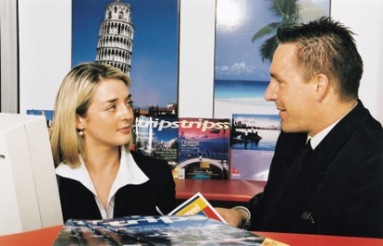
Review documents/evidence
Identify sources of problems
Employee qualities:
Problems may stem from the employee themselves and can include:
Person is new to the role
Person does not understand what they need to do
Person does not have the knowledge and skills to do the task
Notes:
Activity – Discussion
How can these causes or problems be reduced?

Slide 84

Review documents/evidence
Identify sources of problems
Employee qualities:
Person may have personal problems
Person cannot handle stressful situations
Physical problems, such as lack of energy, restricted movement, pain or illness
Notes:
Activity – Discussion
How can these causes or problems be reduced?

Slide 85

Review documents/evidence
Identify sources of problems
Organisational sources:
Limited training
Lack of supervision, direction, instruction or explanation by management
Ineffective rostering of staff
Bad physical work environment and unsafe conditions
Ineffective work processes
Faulty equipment or power cuts
Notes:
Activity – Discussion
How can these causes or problems be reduced?

Slide 86
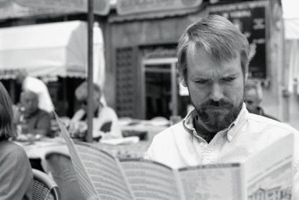
Review documents/evidence
Identify sources of problems
Customer sources
At times, the complaint may be influenced by the customer themselves including:
Large amount of customers coming at the same time
Difficult customers
Unreasonable requests
Notes:
Activity – Discussion
How can these causes or problems be reduced?
What do we do if we find out the customer himself/herself is the cause of the problem?

Slide 87

Collect documents/evidence
Collecting evidence relating to the complaint
This evidence may come in the form of:
Invoices
Discussions with staff
Discussions with other customers
Reviewing of surveillance equipment
Cashiering discrepancy reports
Observations
Findings from external investigations
Notes:
Activity – Discussion
How can you access this evidence?

Slide 88

Update register of complaints
During the evidence collection process, any new information should be updated in the complaint file:
Why is this important?
What information should be recorded?
Notes:
Activity – Discussion
Discuss questions in the slide.

Slide 89

Update register of complaints
Information to contain in file
Details of the person making complaint
Details of the complaint
Chronological order of events
Summary of discussions or activities taken
Record of person’s involved
Evidence collected
Recommendations
Notes:
Activity – Discussion
Why is this information important?
Where should these files or information be kept?

Slide 90
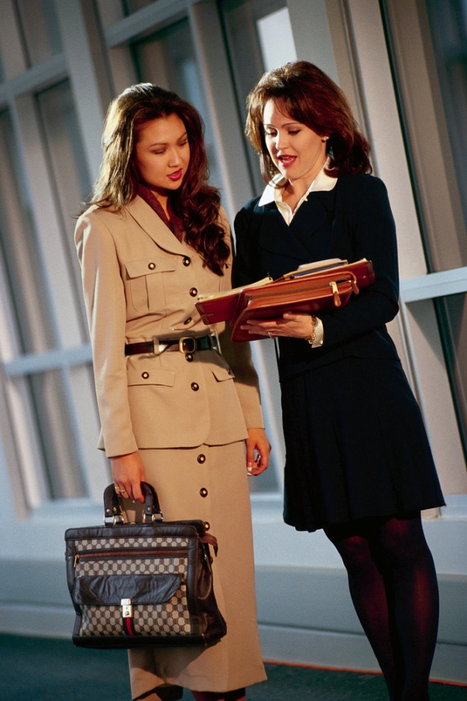
Element 3:
Determine and agree upon appropriate action to resolve complaint
Notes:
Introduce topic.
Class Activity – General Discussion
Ask general questions:
Once you have received a complaint and have agreed on its nature, what is the next step?

Slide 91
Determine and agree upon appropriate action to resolve complaint
Performance Criteria for this Element are:
Identify and review options to resolve procedures and guidelines
Agree and confirm action to resolve the complaint with the customer
Demonstrate a commitment to the customer to resolve the complaint
Inform customer of outcome of investigation of complaint
Notes:
Trainer identifies the Performance Criteria for this Element, as listed on the slide.

Slide 92

Identify and review options to resolve the complaint
Now is the time to discuss and identify a possible solution to the problem
Most complaints can be effectively resolved by more than one solution
Notes:
Activity – Discussion
How can you identify a range of solutions to complaints?

Slide 93

Identify and review options to resolve the complaint
Your aim must be to find a resolution that is:
Quick, easy and practical to implement
Satisfies those involved
Meets the limitations imposed on you by the law and organisational requirements.
Satisfies both customer and organisation
Notes:
Activity – Discussion
What needs to be taken into consideration?

Slide 94

Determining possible solutions
Possible options
What the customer wants
Taking into account all points of view
Organisational policies
Pre-programmed decisions
Non-programmed decisions
Notes:
Activity – Discussion
Why is it important to consider these points when identifying options?

Slide 95

Determining possible solutions
What the customer wants
One easy way to find out how to resolve the complaint is to encouraging the customer to identify what will solve the issue
Quite often all they may seek is an apology or a resolution is easier than what the manager was expecting
Notes:
Activity – Discussion
Why is this the easiest method?
How do you ask the customer?
What do you say if there ideas are not realistic?

Slide 96
Determining possible solutions
Taking into account all points of view
When dealing with a customer compliant it is important to consider the points of view of all parties involved
Notes:
Activity – Discussion
Why is this important?
How should this be approached and managed?

Slide 97

Determining possible solutions
Organisation policies
Formal, written policies on dealing with customer complaints are useful because they:
Provide guidance on what to do in order to resolve situations
Give consistency when dealing with customers
Relieve staff from having to make decisions
Notes:
Activity – Discussion
Who prepares these policies?
Where are they normally located?
How are staff made aware of them?

Slide 98

Determining possible solutions
Organisation policies
These policies may address issues such as:
Who should deal with problems, complaints at different levels
When management or security staff should be involved
The limits of scopes of authority
Situations under which the property will not try to resolve a conflict regardless of what the customer may allege
Documentation for completion
Staff training required
Notes:
Activity – Discussion and Review or create policies
What is the benefit of having policies?
Trainer to show audience some policies that are used in the workplace OR get the audience to create some policies they would implement.

Slide 99

Determining possible solutions
Pre-programmed decisions
Pre-programmed decisions are where a set policy or procedure is used to resolve an identified complaint
Many establishments use pre-programmed decisions to assist with complaint resolution
A pre-programmed decision is a decision that has been thought about and put in place to act as a standard establishment response to a given set of circumstances
Notes:
Activity – Discussion
For what common complaints would pre-programmed decisions be established?

Slide 100

Determining possible solutions
Pre-programmed decisions
Designed for common problems
Provide consistency in decisions made
Saves staff having to determine what action they should take
Notes:
Activity –Review or create pre programmed decisions
Trainer to show audience some policies that are used in the workplace OR get the audience to create their own

Slide 101

Determining possible solutions
Non-programmed decisions
Non-programmed decisions are where specific responses to individual complaints are determined on an individual case by case basis:
What should be the process in these scenarios?
Notes:
Activity –Review or create pre programmed decisions
Discuss question in the slide.

Slide 102

Determining possible solutions
Non-programmed decisions
If there is no pre-programmed action to follow then the manager has four basic options to choose from:
Ask the person what it will take to fix the problem
Meet the customer half-way or part-way
Offer a formal apology
Do nothing
Notes:
Activity – Discussion
Discuss the possible solution techniques

Slide 103

Agree on solution
Once all possible solutions have been placed on the table for consideration, there needs to be a concerted effort to find a mutually agreed solution
Notes:
Activity – Discussion
After discussing options, how can you reach an agreement?
What processes or techniques would you use?

Slide 104

Agree on solution
Constraints when reaching solution
Costs and budgets
Written policies
Availability
Organisational constraints
Legal constraints
Notes:
Activity – Discussion
Why is it important to consider these constraints?
What constraints exist?

Slide 105
Agree on solution
Define agreed solution
In many cases a written course of action will be documented that outlines what action is to take place to resolve the complaint, as agreed by both parties:
Why is it important to document an agreed solution?
What information would you wish to record?
Notes:
Activity – Discussion
Discuss questions in the slide.

Slide 106
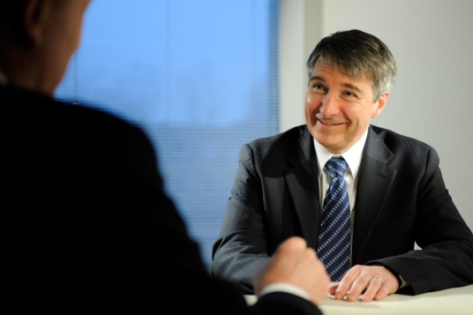
Agree on solution
Define agreed solution
This may include a record and commitment outlining:
Actions or activities to take place
Who is responsible for ensuring action takes place
Who will undertake action
Timelines
Agreed standard of actions
Notes:
Activity – Discussion
Discuss points.

Slide 107
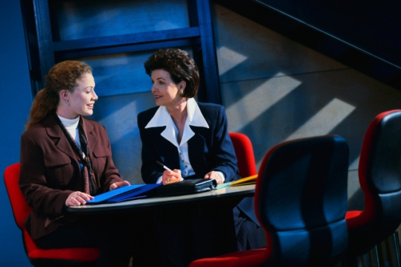
Resolve the complaint
Demonstrate a commitment to resolve the complaint
Now that agreement has been reached it must be actioned
This should be done as soon as possible and must be exactly in accordance with the agreement that had been reached
Notes:
Activity – Discussion
How can you demonstrate a commitment to resolve the complaint?
What action would you take?

Slide 108
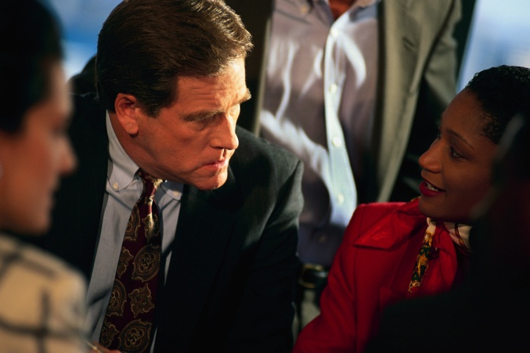
Resolve the complaint
Demonstrate a commitment to resolve the complaint
Complaint resolution activities can be done by:
Manager or staff member themselves
Delegated to another person
Notes:
Activity – Discussion
If activities are delegated to another person for their follow up what should the manager do?

Slide 109

Resolve the complaint
Delegated resolution to another person
The manager or staff member must:
Explain the complaint to the correct individual
Ensure it is being completed within the specified time frame
Keep the customer informed of the progress of the resolution
Ensure the complaint has been resolved in accordance with the agreement and to the customer’s satisfaction
Notes:
Activity – Discussion
Discuss the importance of these points.

Slide 110

Resolve the complaint
Inform customer of outcome of investigation of complaint
Inform customer of outcome
Keep customer informed
Follow up with customer
Notes:
Activity – Discussion
Discuss the importance of these points.

Slide 111
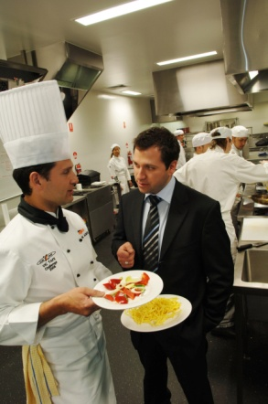
Investigate complaint
Reasons for undertaking investigatory activities are to:
Identify problem
Ascertain the causes of the problem
Seek remedies to reduce it
Notes:
Activity – Discussion
Do all complaints need thorough investigation?
What ways can you investigate complaints?

Slide 112
Investigate complaint
Some complaints that may NOT require investigation include:
Human error
Cultural or language misunderstanding
Communication error
Problem with machinery
Simple procedural error
Uncontrollable event
Something out of the control of the organization
Notes:
Activity – Discussion about complaints not requiring investigation
Human error – a bed sheet was dirty or meal undercooked
Cultural or language misunderstanding – customer with limited local language ability misunderstood menu item
Communication error - someone forgot to pass on a message
Problem with machinery – television in room didn’t work or internet didn’t connect
Simple procedural error – there was a delay in getting room service to a room
Uncontrollable event – everyone checked-out at the same time causing delays
Something out of the control of the organization, like a power cut or internet was slow

Slide 113

Investigate complaint
Some complaints requiring investigation include:
Those occurring on a regular basis
Those of a serious nature
Those which can be improved
Those which can be solved through training
Notes:
Activity – Discussion about complaints requiring investigation
Occur on a regular basis – delays in check-in or check-out
Are of a serious nature – such as food poisoning, sexual harassment or death
Can be improved – furniture and furnishings are outdated
Can be solved through training.

Slide 114

Element 4:
Refer complaints
Notes:
Introduce topic.
Class Activity – General Discussion
Ask general questions:
When would you refer a complaint?
How is this decided?
Who are complaints referred to?
What is your role once a complaint has been referred to someone else?

Slide 115

Refer complaints
Performance Criteria for this Element are:
Identify complaints that require referral to other personnel or external bodies
Refer complaint to appropriate personnel for follow-up in accordance with individual level of responsibility
Forward all necessary documentation including investigation reports to appropriate personnel
Refer escalated complaints which cannot be resolved to an appropriate person
Notes:
Trainer identifies the Performance Criteria for this Element, as listed on the slide.

Slide 116
Identify complaints for referral
Whilst most complaints can be handled by individual staff members or managers within their scope of authority, at times complaints may need to be referred to executive management or external bodies:
What complaints are commonly referred?
Notes:
Activity – Discussion
Discuss question in the slide.

Slide 117

Identify complaints for referral
Common complaints for referral
This normally relates to matters:
Of a serious nature
Where specialist skills, knowledge and equipment is needed to determine evidence
Where criminal activity has taken place
Where scope of authority is exceeded
Notes:
Activity – Discussion about common complaints for referral
Of a serious nature – such as death, assault, theft etc.
Where specialist skills, knowledge and equipment is needed to determine evidence such as financial statements and records from banks or security surveillance equipment
Where criminal activity has taken place
Where scope of authority is exceeded

Slide 118

Refer complaint to appropriate person
When it has been determined that a complaint needs to be referred to another person it must be done so in a timely manner:
Who is the appropriate person?
Notes:
Activity – Discussion
Who are complaints normally referred to and why?

Slide 119

Refer complaint to appropriate person
Appropriate internal persons
The appropriate person, in some situations, may be:
A co-worker who has more experience than you
Higher manager
Security
Notes:
Activity – Discussion
Who else could you refer the matter to within the company?

Slide 120
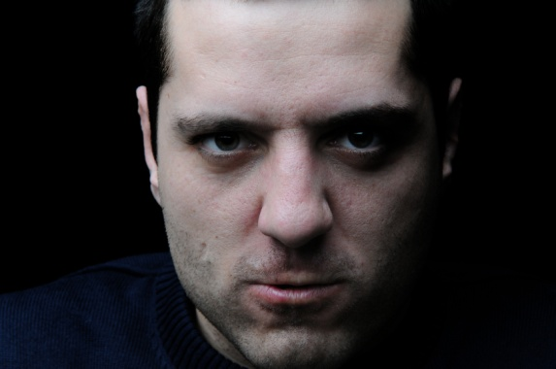
Refer complaint to appropriate person
Appropriate internal persons when handling intoxicated patrons
It must be remembered, that the health and safety of staff and customers is the primary objective when handling complaints, especially instances involving intoxication
As a staff member, it is not a requirement for you to place yourself in harm’s way if you feel you cannot handle the situation
Notes:
Activity – Discussion
If an intoxicated customer gets out of control, who can you contact?

Slide 121

Refer complaint to appropriate person
Appropriate internal persons when handling intoxicated patrons
Supervisor/Management
Security
DJ
Notes:
Activity – Discussion
Supervisor/Management – they will make or authorise courses of action to take
Security – they will have the expertise to deal with the matter
DJ – they have the capacity to communicate not only with different authorities but can also communicate directly to the patrons within the venue

Slide 122

Refer complaint to appropriate person
Appropriate external persons
Police
Fire
Ambulance
Security company
Notes:
Activity – Discussion
Police – in the event of any activity that is breaking the law or likely to increase the risk of harm to all patrons and staff
Fire – if there appears to be a likelihood of fire
Ambulance – in the event a person requires medical assistance

Slide 123
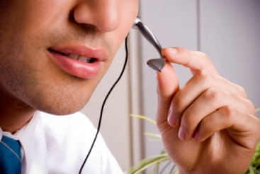
Refer complaint to appropriate person
Reaching suitable external assistance
Easy to reach contact details can include:
Special button
Posters with contact numbers
Speed dials
Other methods that are suitable
Notes:
Activity – Discussion
Why is it important to have easy to reach numbers?
What is the best way to contact external people in emergency situations?

Slide 124
Forward documentation
Forward all necessary documentation including investigation reports to appropriate personnel
By having accurate and completed records and evidence, it helps them to gain an understanding of all aspects of the matter in a more effective manner
Notes:
Activity – Discussion
What else can you do to help ensure the person responsible for resolving the complaint has all the information they need?

Slide 125

Forward documentation
Follow up with appropriate personnel
Whilst handing of written documentation and evidence is a great way to provide assistance to those to whom responsibility has been given for undertaking further activity, it is also worthwhile to meet with them personally to conduct a handover
Notes:
Activity – Discussion
What would be discussed in a handover?

Slide 126

Forward documentation
Follow up with appropriate personnel
Benefits of conducting a personal handover include:
Background information can be summarised
Key points can be highlighted
A first hand account of activities can be explained, including reasoning for specific actions
Sensitive or confidential information can be identified and explained
Any queries can be clarified
Any further information or questions that others may have can be answered
Notes:
Activity – Discussion
What would be discussed in a handover?

Slide 127
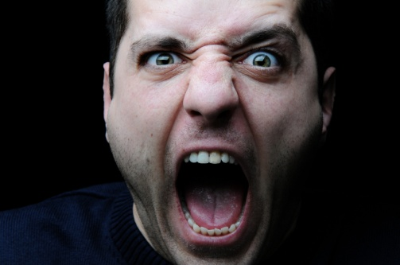
An escalated complaint
Types of escalated complains
The organisational policies specifically call for the complaint to be handled by management or some other nominated person
Every genuine effort on your part to resolve the issue has been unsuccessful
Physical confrontation is likely
Customer is swearing, making threats or drawing substantial attention to themselves
Notes:
Activity – Discussion
What do you do in these escalated situations?
Who should handle these situations?

Slide 128

An escalated complaint
Types of escalated complains
The customer is alleging impropriety, dishonesty or other fraudulent activity on behalf of a staff member
Customer intends taking legal action
Customer intends referring the complaint to the authorities
Customer intends taking the issue to the media
Notes:
Activity – Discussion
What do you do in these escalated situations?
Who should handle these situations?

Slide 129

Summary
Whilst customer complaints are often seen in a negative light, they can be an opportunity to turn an unfortunate situation into a positive learning experience.
Notes:
Activity – Discussion
Discuss the importance of why a customer complaining can be seen as a positive interaction.

Slide 130
Revision and Assessments
It is now time to complete any:
Revision
Activities
Assessments
Notes:
Class Activity – Revision and Assessments
Explain Revision and Assessments
Trainer to give trainees time to undertake Revision and Assessments

Slide 131

Finish:
Thank you!
Notes:
This is the conclusion of the subject.
Thank the trainees and deliver assessments as required.

